Slide 1
Swift language
loop practice

Slide 2
Ffor loop format
for value in range {
Statement 1
Statement 2
Statement n
}

Slide 3
For loop format
for n in 1...10 { // n = 1 … 9
print(n)
}
for n in 1...10 { // n = 1 … 9
print(n, “ “,terminator:"")
}

Slide 4
For loop format
for index in stride(from: 1, to: 10, by: 3){
print(index) “ “,terminator:"")
}
for index in stride(from: 15, to: 6, by: -2){
print(index) “ “,terminator:"")
}

Slide 5
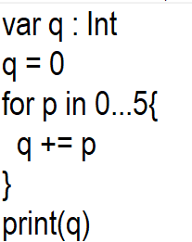
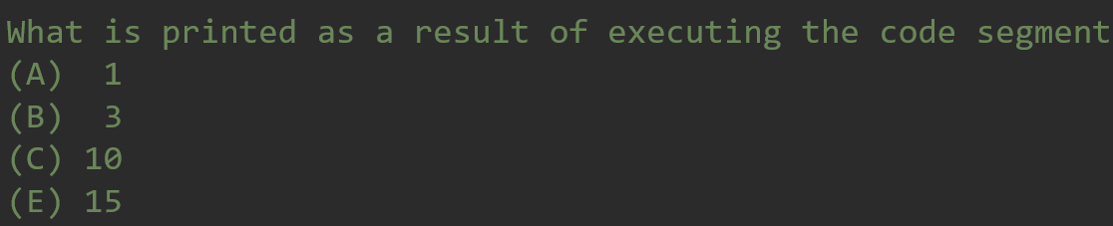
var q : Int
q = 0
for p in 0...5{
q += p
}
print(q)

Slide 6
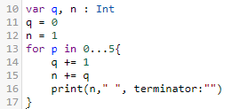
What is the output of the following program?
var q, n : Int
q = 0
n = 1
for p in 0...5{
q += 1
n += q
print(n," ", terminator:"")
}

Slide 7
What is the output of the following program?
// 12 - 5 - 1
var p, q : Int
p = 10
q = 5
while (q != 0 && p / q > 0) {
p -= 1
print(p,"",q)
q -= 1
}

Slide 8
What is the output of the following program?
//11 - 20 0
var p, q : Int
p = 10
q = 5
while (p > 0 && q > 0){
p += 1
if (p % 2 == 0){
q -= 1
}
print(p,"",q)
}

Slide 9
What is the output of the following program?
// 10-27
var n, count : Int
n = 6
count = 0
for p in 1 ... n {
for q in 0 ... p {
count += 1
}
}
print(count)

Slide 10
What is the output of the following program?
// 9-28
var count : Int
count = 0
for p in 0 ... 6{
for q in p ... 6 {
count += 1
}
}
print(count)

Slide 11
What is the output of the following program?
// 8
var k : Int
k = 0
for p in 1...6{
k += 1
}
k += 1
print(k)

Slide 12
What is the output of the following program?
// 7
var p, q : Int
p = 4
q = 5
while (p > q){
if(p % 2 == 0){
p -= 1
} else {
q += 1
}
}
print(q,"",p)

Slide 13
What is the output of the following program?
// 6
var q, n : Int
q = 0
n = 0
for p in 0 ... 10{
q += 1
n += q
print(p,"",terminator:"")
}

Slide 14
What is the output of the following program?
// 5
var q : Int
q = 0
for p in 0 ... 5{
q += p
}
print(q)

Slide 15
What is the output of the following program?
var x, n:Int
x = 0
for y in 1...13{
n = y
while x <= y {
if (x % 2 == 0){
x += 2
}
else{
n -= 2
}
}
if(n > 13){
break
}}
print(x)

Slide 16
What is the output of the following program?
var count : Int
count = 5
for p in 1...7{
if (p % 3 == 0){
count -= 1
}
else{
count += 1
}
}
print(count)

Slide 17
What is the output of the following program?
var p, q : Int
p = 0
while (p < 5){
q = 0
while (q < 4){
p += q
q += 1
print(p, " ", q, "\n")
}
}

